Slide 1

Java Programming Cornerstone Project
Final Review
Library Management System
Presented by
Gorogodo Takunda Leonard (24B11CS488)
M Naga Abilash (24B11CS267)
Nyamhamba Budwell K (24B11CS511)
Karri Lokesh(25B21CS080)
Department of Computer Science and Engineering

Slide 2




Presentation Outline
Abstract
Introduction
System Analysis
Database Design
System Design
System Implementation
Future Enhancements
References
Conclusion

Slide 3
ABSTRACT
The Library Management System (LMS) is an automated Java application designed to streamline library operations and resource tracking.
The system features Role-Based Access Control (RBAC) for Librarians, Faculty, and Students.
It automates book inventory, seat reservations, and fine management to reduce manual paperwork.
Developed using Java Swing for the GUI and JDBC for secure, centralized data storage.

Slide 4
INTRODUCTION
Managing a library manually involves complex record-keeping of books, members, and transactions.
Traditional systems struggle with tracking overdue books and managing fine payments efficiently.
This automated LMS simplifies book circulation and resource management.
The project focuses on a secure, role-based application to improve library accessibility and data accuracy

Slide 5
SYSTEM ANALYSIS
Functional Requirements
Librarian: Manage members (Add/Remove), manage inventory (Add/Remove books), and allocate study seats.
Faculty: Search/Issue books and automated fine deduction from salary for overdue items.
Student: Search/Issue books, book study seats, and automated fine addition to college fees.
Login Module: Secure authentication for all three user roles

Slide 6
SYSTEM ANALYSIS
Hardware & Software Requirements
Hardware:
Intel i3 or above
4GB RAM,
20GB Storage.
Software:
Language: Java (JDK 8+).
IDE: VS Code / IntelliJ IDEA.
Database: MySQL / Oracle Database.
GUI: Java Swing / AWT.

Slide 7
Database Design
The system uses a relational database to store library information efficiently. and helps in redundancy reduction.Tables are as follows:
Member Table: Stores UserID, Name, Role (Librarian/Faculty/Student), and Contact details.
Book Table: Stores BookID, Title, Author, and Availability Status.
Transaction Table: Tracks Issue Date, Return Date, and calculated Fines.
Seat Table: Manages seat numbers and booking status for students.

Slide 8
Database Design
Database Tables:
Users Table :
Stores department details (Librarians , Faculty etc)
Field Name | Data Type | Key | Description
UserID | INT | Primary Key | UserID
name | VARCHAR(50) | — | Full name of user
UserRole | VARCHAR(200) | — | Defines access name

Slide 9
Database Design
Database Tables:
Issue/Return Table :
tracks book movements and links to the fine management logic.
Field Name | Data Type | Key | Description
TransactionID | INT | Primary Key | Transaction Record
BookID | INT | Foreign Key | References Books Table
UserID | INT | Foreign Key | References Users Table
DueDate | DATE | — | Expected return date
IssueDate | DATE | __ | Date book is borrowed
ReturnDate | DATE | __ | Actual return date

Slide 10
Database Design
Database Tables:
Login Table :
Stores login credentials linked to a user
Field Name | Data Type | Key | Description
loginID | INT | Primary Key | Unique login record
username | VARCHAR(50) | Unique | Username
password | VARCHAR(100) | — | Encrypted Password
UserID | INT | Foreign Key (Unique) | References to Users Table

Slide 11
SYSTEM DESIGN
Modules:
SYSTEM DESIGN (Modules)
Member Management: Librarian interface to register or remove users.
Inventory Module: Librarian interface to update the book catalog.
Seat Allocation: Logic for student booking and librarian manual override/allocation.
Fine Management: Automated logic to route fines to Salary (Faculty) or Fees (Students).
Search Module: Quick retrieval of books by ID, Title, or Author.

Slide 12
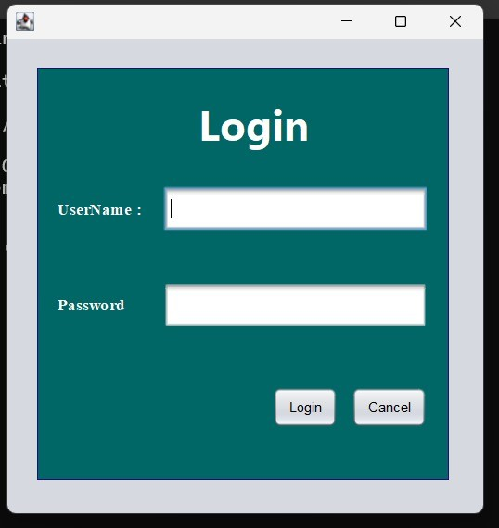
System Implementation
Login window:
Validates credentials and redirects users to their specific dashboard based on role.

Slide 13
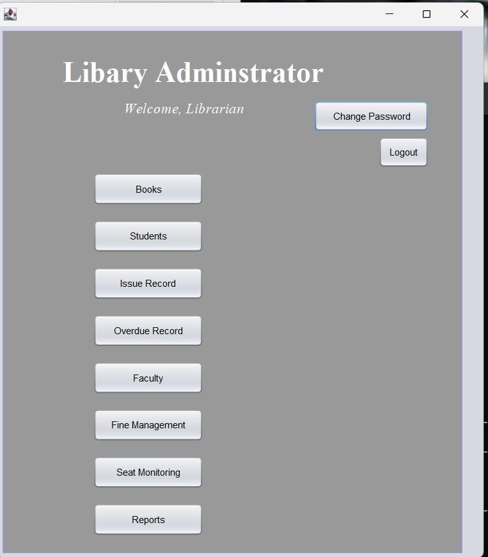
System Implementation
Librarian Dashboard:
Links to Member Management, Book Management, and Seat Allocation.

Slide 14
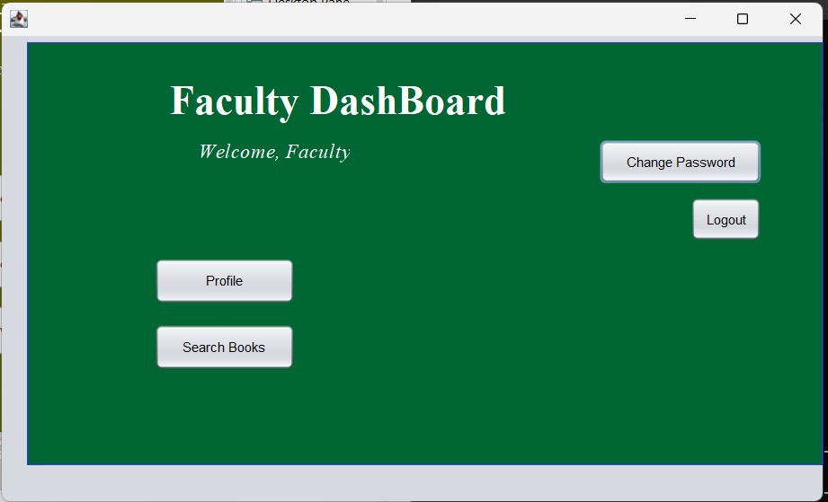
System Implementation
Faculty Dashboard:
Book search ,Profile and many other operations

Slide 15
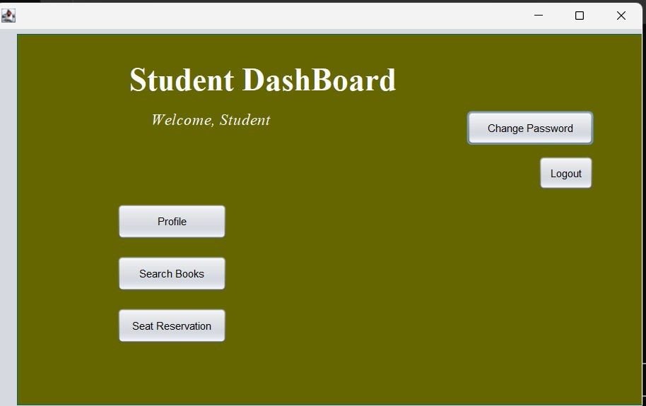
System Implementation
Student Dashboard:
Book search, Seat booking, and Profile.

Slide 16
Future Enhancements
The Library Management System developed in this project provides basic functionalities for managing employee records. However, the system can be further enhanced by adding advanced features to improve its functionality and usability.Some possible future enhancements include:
E-Library Integration: Adding digital PDF versions of books for remote access.
Barcoding/RFID: Automating book check-ins/check-outs using scanners.
Mobile App: Developing a cross-platform mobile app for real-time notifications.
Recommendation System: Suggesting books based on user borrow history.

Slide 17
References
The following references were used during the development of the Library Management System:
Herbert Schildt, Java: The Complete Reference, Oracle Press.
Oracle Database & JDBC Documentation.
Java Swing Tutorials (TutorialsPoint/GeeksforGeeks).
W3Schools Java Programming Guide.

Slide 18
CONCLUSION
The Library Management System provides a streamlined digital solution for modern educational institutions.
Role-based access ensures data security and operational efficiency.
Automated fine processing reduces administrative overhead for both faculty and student accounts.
The system successfully replaces error-prone manual tracking with a reliable Java-based application.

Slide 19
THANK YOU

